Slide 1
School Management System
Prepared by Dha Lhamu Lama
Batch 21

Slide 2
Analysis
Use Case Diagram
Definition: A use case diagram is a graphic depiction of the interactions among the elements of a system.
A use case is a methodology used in system analysis to identify, clarify, and organize system requirements. In this context, the term "system" refers to something being developed or operated, such as a mail-order product sales and service Website. Use case diagrams are employed in UML (Unified Modeling Language), a standard notation for the modeling of real-world objects and systems.

Slide 3
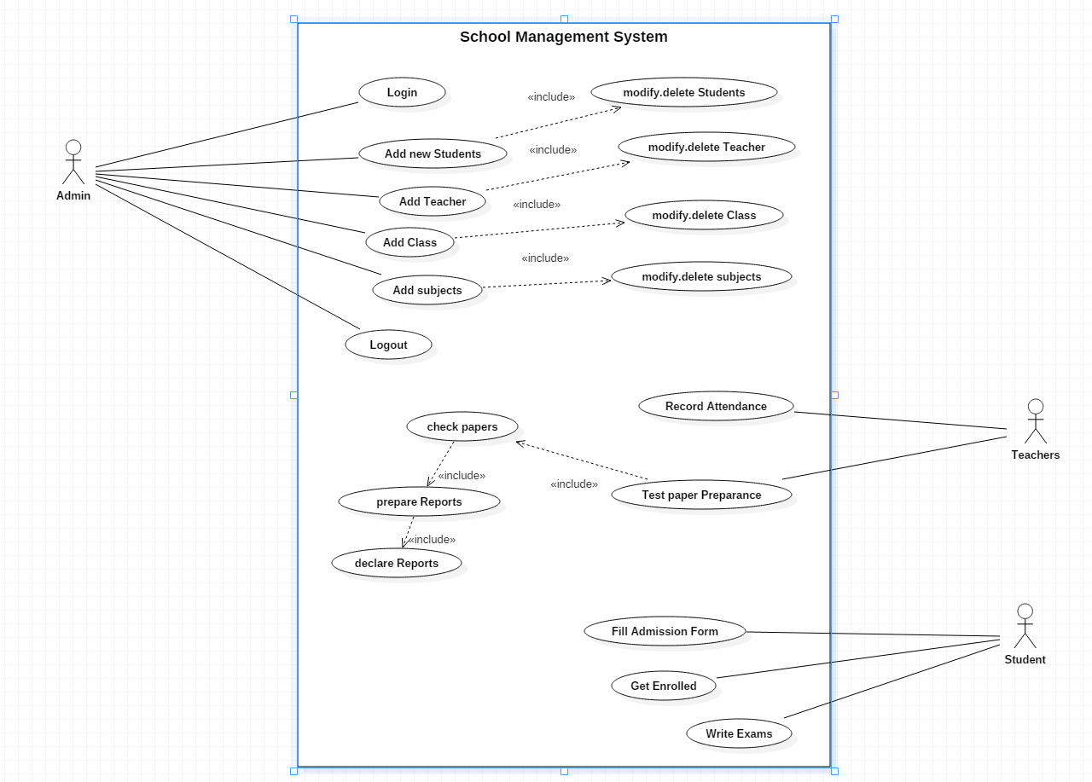
Fig: Use case diagram for School Management System

Slide 4
Justification: A use case is a methodology used in system analysis to identify, clarify, and organize system requirements. The use case is made up of a set of possible sequences of interactions between systems and users in a particular environment and related to a particular goal.

Slide 5
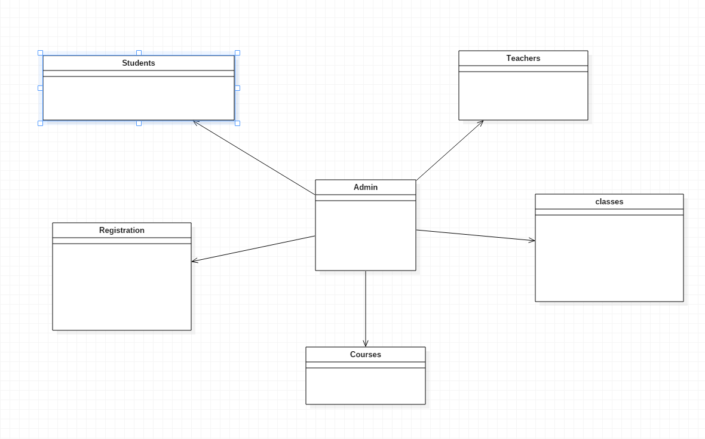
Initial Class Diagram
Definition: class diagram to show the classes and relationships. A class diagram shows classes, the relationships between classes, constraints, and attributes of classes. The diagram is helpful in designing and building a system because it can be used as the blueprint for the final product.
Fig: Initial Class Diagram

Slide 6
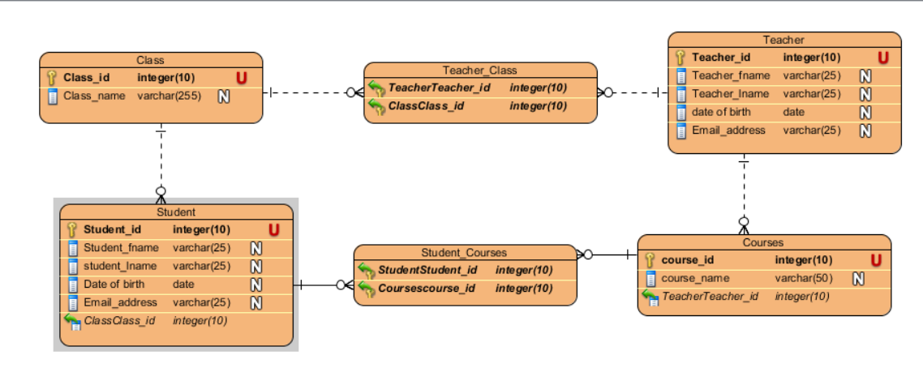
ER diagram for School Management System
Definition: An entity-relationship diagram (ERD) is a data modeling technique that graphically illustrates an information system's entities and the relationships between those entities. An ERD is a conceptual and representational model of data used to represent the entity framework infrastructure.
Fig: ER Diagram
ER diagrams are used to analyze existing databases to find and resolve problems in logic or deployment. Drawing the diagram should reveal where it's going wrong. Business information systems: The diagrams are used to design or analyze relational databases used in business processes.

Slide 7
Functional and non-functional requirement for School Management System
Functional requirement: Functional requirements are those which are related to the technical functionality of the system
Non-functional requirement: It is a requirement that specifies criteria that can be used to judge the operation of a system in particular conditions, rather than specific behaviors.
Functional(F)/Non-functional(NF) | Requirements | MoSCoW
NF(R1) | Login | M
NF(R2) | Registration | M
F(R3) | Admission Process | M
F(R4) | Update Information | S
F(R5) | Delete Information | C
F(R6) | Retrieve Information | S
F(R7) | Create Information | S
NF(R8) | Fees Information | S
NF(R9) | Teacher Information | S
NF(R10) | Student Information | M
F(R11) | Routines | M
F(R12) | Results | M
F(R13) | Laboratory | M
F(R14) | Salary | M
NF(R15) | Calendar | S

Slide 8
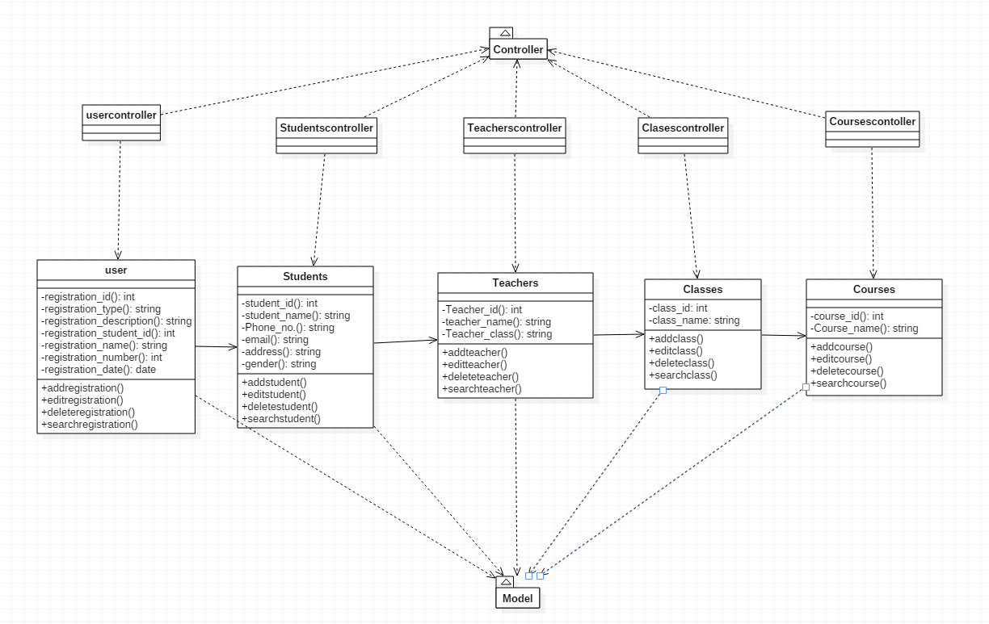
Design
Class diagram
Fig: Class Diagram

Slide 9
Justification: A class diagram is an illustration of the relationships and source code dependencies among classes in the Unified Modeling Language (UML). In this context, a class defines the methods and variables in an object, which is a specific entity in a program or the unit of code representing that entity. Class diagrams are useful in all forms of object-oriented programming (OOP). The concept is several years old but has been refined as OOP modeling paradigms have evolved.

Slide 10
Activity Diagram
Definition
Activity diagram: An activity diagram visually presents a series of actions or flow of control in a system similar to a flowchart or a data flow diagram. Activity diagrams are often used in business process modeling. They can also describe the steps in a use case diagram. Activities modeled can be sequential and concurrent.

Slide 11
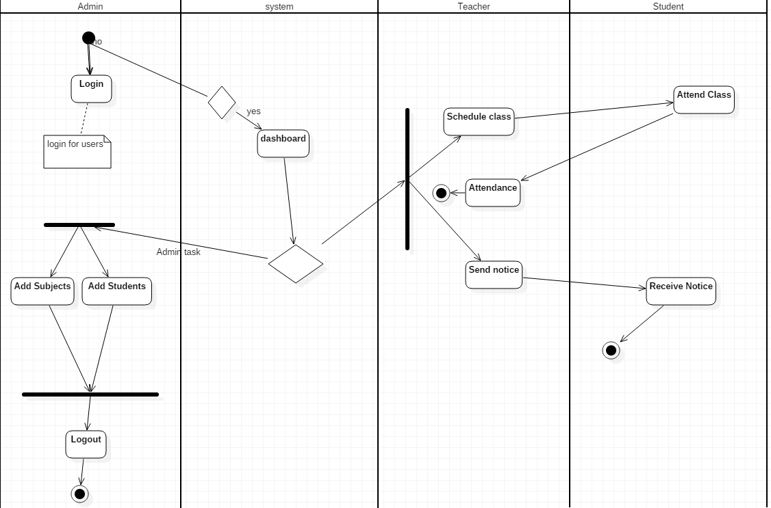
Fig: Diagram of activity diagram

Slide 12
Justification: Purpose of Activity Diagrams. The basic purposes of activity diagrams is similar to other four diagrams. It captures the dynamic behavior of the system. Other four diagrams are used to show the message flow from one object to another but activity diagram is used to show message flow from one activity to another.

